Slide 1


PREDICTING STOCK PRICES USING A
THREE-LAYER LSTM MODEL ON
ALPHABET INC (GOOG)
Presenter: Dwij Kishor Siyal
ID: 200492977
Course: CS 715 - Advanced Machine Learning
Project Guide: Professor Yao

Slide 2
CONTENTS
1
1
Introduction
2
Methodology
3
Results
4
Future Work
5
Conclusion

Slide 3
INTRODUCTION
2
  Challenges and Importance of Stock Price Prediction
    Stock market prediction is complex due to volatility and non-linear data patterns.
    Helps traders and investors make informed decisions, mitigate risks, and maximize profits.
  Hansun and Young's Three-Layer LSTM Model
    Designed for predicting closing prices in the LQ45 index.
    Effective in capturing temporal dependencies, evaluated with MAPE and RMSE metrics.
  Adaptation for Alphabet Inc.
    Extended to predict Open, High, Low, and Close prices of Alphabet Inc.
    Tested adaptability in the NASDAQ market with focus on candlestick charts and practical trading strategies.

Slide 4
INTRODUCTION
3
  Project Objective
    Implement and evaluate Hansun and Young's three-layer LSTM model for predicting Alphabet Inc. (GOOG) stock prices (Open, High, Low, Close).
  Methodology and Validation
    Adapted the model to a new dataset to assess robustness across different market conditions.
  Exploring Practical Implications
    Analyzed candlestick-based predictions to identify favorable and risky situations.

Slide 5
METHODOLOGY
4
Step 1: Data Collection
  Gathered Alphabet Inc. (GOOG) stock data using Yahoo Finance API.
  Dated from 1-Jan-2010 to 31-Dec 2023. (daily data)
Step 2: Data Preprocessing
  Used Pandas and Scikit-learn libraries to clean, normalize, and prepare the data for analysis.
Step 3: Model Design
  Built the three-layer LSTM model with variation using TensorFlow's Sequential API.
Step 4: Model Training
  Trained the model on the preprocessed data to predict Open, High, Low, and Close prices.
Step 5: Model Evaluation
  Assessed model performance using metrics like MAPE and RMSE.
Step 6: Results Visualization
  Visualized findings and trends with Plotly and Matplotlib libraries.

Slide 6
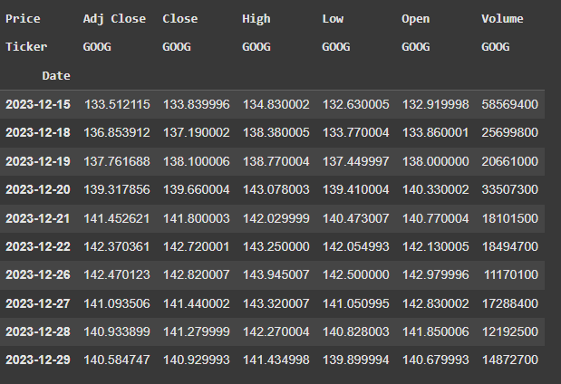
RESULTS
5
  Displaying data’s last 10 values to get an idea of schema.

Slide 7
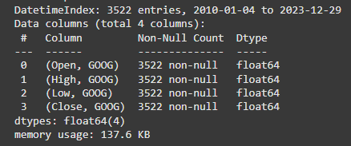
RESULTS
6
  Used Forward Fill method to counter any null values in the dataset.
    google_stock_df.ffill(inplace=True)

Slide 8


RESULTS
7
  Used MinMaxScaler to normalize data in the range of 0-1.
  Created sequence of 60 time-steps for LSTM input.
  Divided training and testing sets into 80:20 ratio.

Slide 9
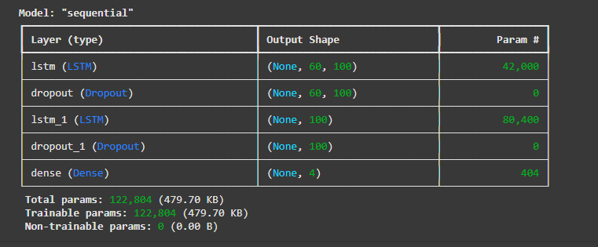
RESULTS
8
  Used the basic architecture of Hansun, S., & Young, A from their paper and modified by adding one more Layer of LSTM and dropout layer keeping it simple enough and effective for four variable prediction.
    model.summary()

Slide 10
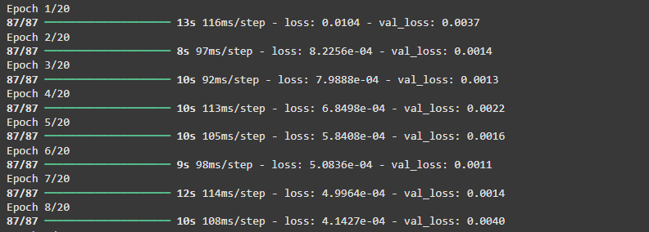
RESULTS
9
  Performed 20 epochs on batch size of 32 (similar to what Hansun, S., & Young, A used in their model).
  Optimizer: Adam
  Loss function: mean_squared_error

Slide 11

RESULTS
10
  Evaluation metrics for model includes:
  RMSE (Root Mean Square Error)
  MAPE (Mean Absolute Percentage Error)

Slide 12
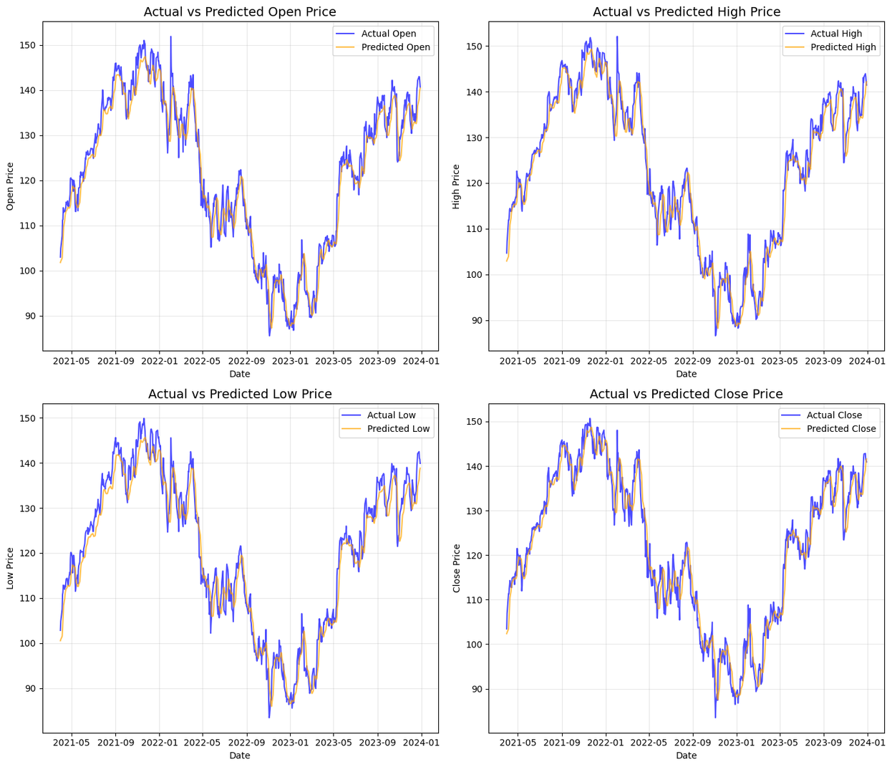
RESULTS
11
Single step prediction

Slide 13
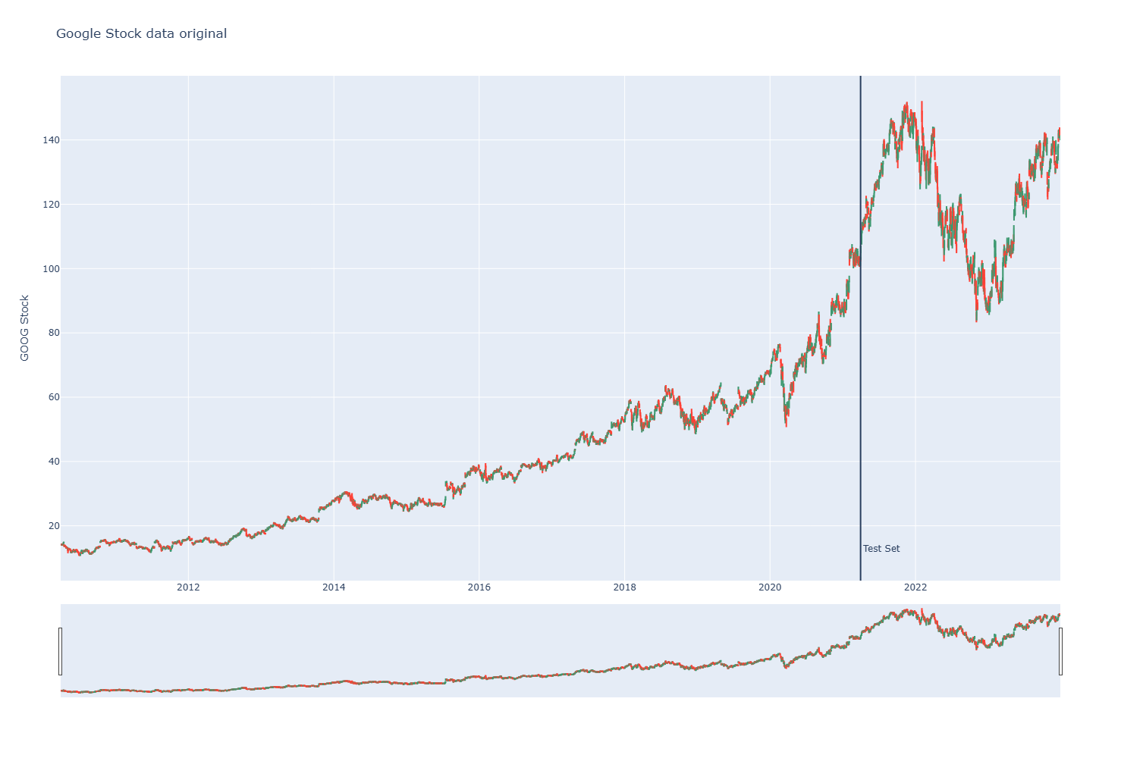
RESULTS
12
Candlestick Visualization of original data

Slide 14
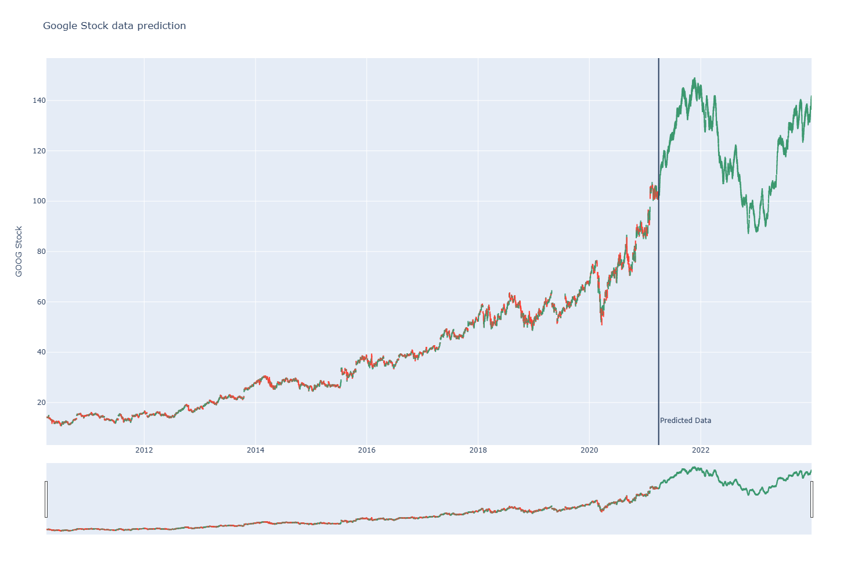
RESULTS
13
Candlestick Visualization of predicted data

Slide 15
FUTURE WORK
14
  Multi-Step Predictions: Future iterations could expand the model to predict multiple future time steps, providing a broader view of potential trends and enabling traders to plan more effectively.
  Incorporate Market Indicators: Adding features such as trading volume, moving averages, RSI, or Bollinger Bands could enhance the model’s ability to predict both upward and downward trends accurately.
  Experiment with Loss Functions: Exploring alternative loss functions, such as Huber Loss or Log-Cosh Loss, may help reduce the sensitivity to outliers and address the bias toward upward trends.
  Enhance Model Architecture: Combining LSTMs with attention mechanisms or convolutional layers could improve feature extraction and provide a more comprehensive understanding of market dynamics.

Slide 16
CONCLUSION
15
  This project successfully implemented and evaluated Hansun and Young's three-layer LSTM model (with some variations) for predicting four stock price variables of Alphabet Inc. (GOOG).
  The results demonstrated the model's ability to capture temporal patterns in financial data and highlighted its potential for practical applications in trading strategies.
  By addressing its limitations through multi-step forecasting, additional features, and enhanced architectures, the model could serve as a powerful tool for traders and analysts navigating complex financial markets.

Slide 17
REFERENCES
16
  Hansun, S., & Young, A. (2021). A Three-Layer LSTM Model for Stock Price Prediction - https://doi.org/10.1186/s40537-021-00495-x
  Plotly Documentation:
    How to plot distributions - https://plotly.com/python/distplot/
    How to plot candlesticks - https://plotly.com/python/candlestick-charts/
  Increasing size of candlesticks - https://stackoverflow.com/questions/73707690/how-to-increment-the-size-of-candlesticks-with-plotly
  How to use yfinance API in python - https://www.geeksforgeeks.org/how-to-use-yfinance-api-with-python/

Slide 18
THANK YOU

